Slide 1
NLP(Natural Language Preprocessing)

Slide 2
Preprocessing Steps for Natural Language Processing
1. Text Cleaning
In this step, we will perform fundamental actions to clean the text. These actions involve transforming all the text to lowercase, eliminating characters that do not qualify as words or whitespace, as well as removing any numerical digits present.
I. Converting to lowercase
Python is a case sensitive programming language. Therefore, to avoid any issues and ensure consistency in the processing of the text, we convert all the text to lowercase.
II. Removing URLs
When building a model, URLs are typically not relevant and can be removed from the text data.
For removing URLs we can use ‘regex’ library.
III. Removing remove non-word and non-whitespace characters
It is essential to remove any characters that are not considered as words or whitespace from the text dataset.
df = df.replace(to_replace=r'[^\w\s]', value='', regex=True)

Slide 3
IV. Removing digits
It is important to remove all numerical digits from the text dataset. This is because, in most cases, numerical values do not provide any significant meaning to the text analysis process.
df = df.replace(to_replace=r'\d', value='', regex=True)
2. Tokenization
Tokenization is the process of breaking down large blocks of text such as paragraphs and sentences into smaller,
3. Stopword Removal
Stopwords refer to the most commonly occurring words in any natural language.
For the purpose of analyzing text data and building NLP models, these stopwords might not add much value to the meaning of the document. Therefore, removing stopwords can help us to focus on the most important information in the text and improve the accuracy of our analysis.
One of the advantages of removing stopwords is that it can reduce the size of the dataset, which in turn reduces the training time required for natural language processing models.

Slide 4
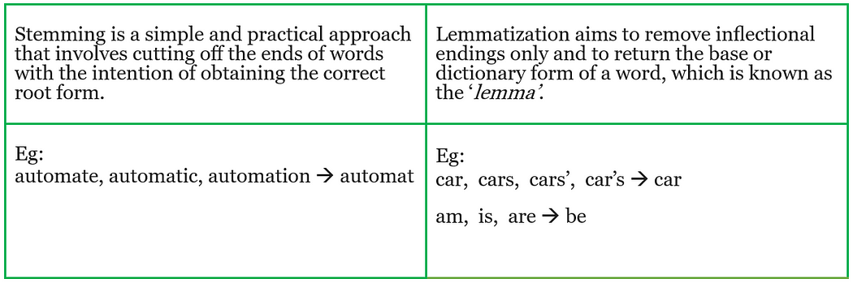
4. Stemming/Lemmatization
What’s the difference between Stemming and Lemmatization?

Slide 5
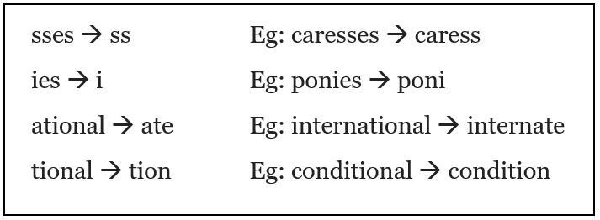
There are various algorithms that can be used for stemming,
· Porter Stemmer algorithm
· Snowball Stemmer algorithm
· Lovins Stemmer algorithm

Slide 6
Types of Tokenization
Tokenization methods vary based on the granularity of the text breakdown and the specific requirements of the task at hand. These methods can range from dissecting text into individual words to breaking them down into characters or even smaller units
Word tokenization. This method breaks text down into individual words. It's the most common approach and is particularly effective for languages with clear word boundaries like English.
Character tokenization. Here, the text is segmented into individual characters. This method is beneficial for languages that lack clear word boundaries or for tasks that require a granular analysis, such as spelling correction.
Subword tokenization. Striking a balance between word and character tokenization, this method breaks text into units that might be larger than a single character but smaller than a full word. For instance, "Chatbots" could be tokenized into "Chat" and "bots". This approach is especially useful for languages that form meaning by combining smaller units or when dealing with out-of-vocabulary words in NLP tasks.

Slide 7
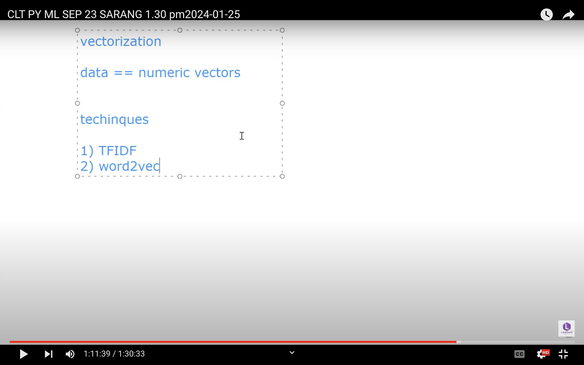

Slide 8
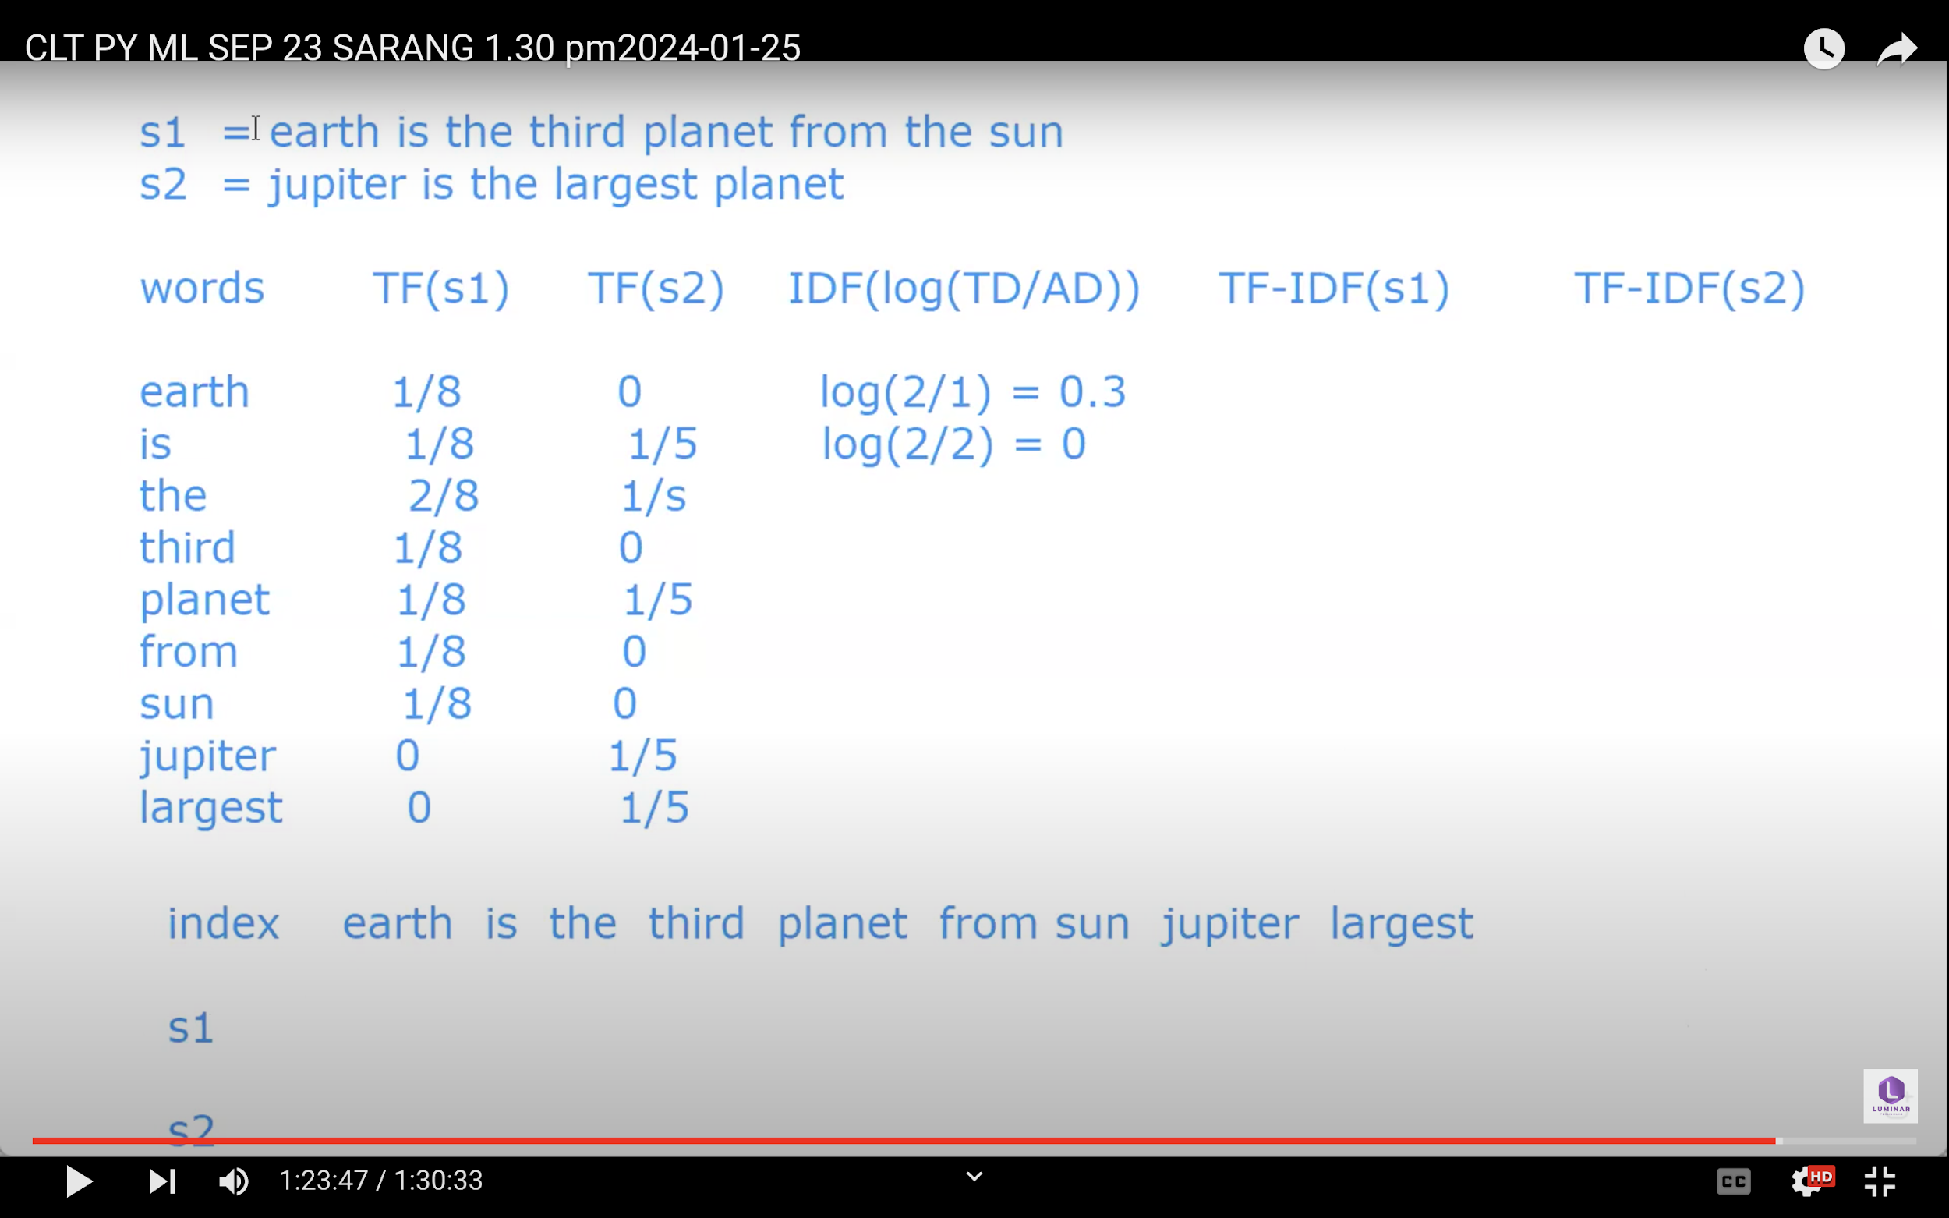
s2

